Slide 1
Single Motor Double Door Opener Mechanism

Slide 2
ABSTRACT
Opening and closing of double doors is always a tedious job, especially in places like shopping malls, hotels and theatres where a person is always required to open the door for visitors.
For people in wheelchairs (disabled persons), it is very difficult to open the door.
Door system provides advance automation for owners. You must have seen door openers in shopping malls, theatres and commercial buildings. These systems are used to open the door

Slide 3
ADVANTAGES
Single motor actuation
Automated doors

Slide 4
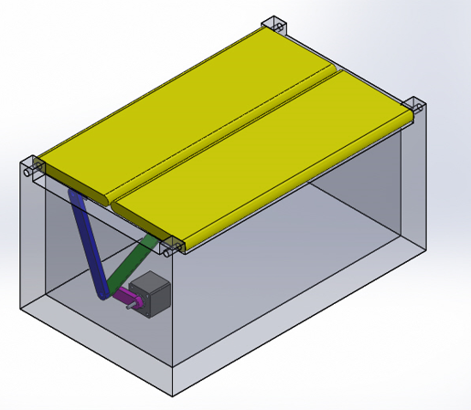
BLOCK DIAGRAM

Slide 5
COMPONENTS USED
Geared Motor
Shaft Rod
Motor Mount
Connecting Rods
L Angles
Mounts and Joints
Supporting Frame
Screws and Bolts

Slide 6







PROJECT DEVELOPMENT STAGES
Testing
Project Assembly
Parts Fabrication
Parts Procurement
Project Design
Finalizing Mechanisms

Slide 7
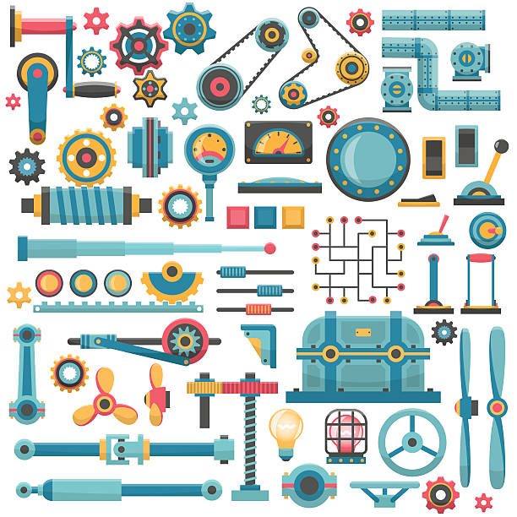
FINALIZING MECHANISMS
Make a List of Required Hardware Outputs
Examine the Mechanism Architecture
Select the Architecture
Identify Motion Needs
Start Searching for Mechanisms & Parts
Examine Costs and Power Constraints
Check Part Availability
Calculate Sizes
Fabricate Parts

Slide 8
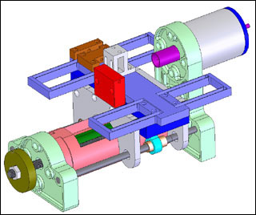
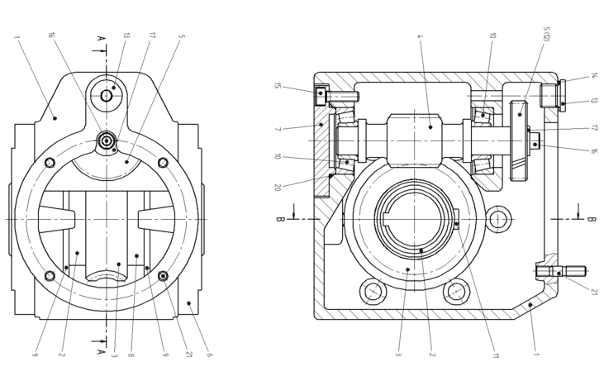
PROJECT DESIGN
Mechanical Design or Machine Design is one of the important branches of Engineering Design. To understand what exactly machine design or mechanical design is let us consider the example of the gear box of the car. The gear box transmits the motion and the power of the engine to the wheels of the vehicle. The gearbox comprises group of gears which are subjected to not only motion but also the load of the vehicle. For the gears to run at desired speeds and take desired loads it is important that they should be designed.
Note : Above images are for reference purposes only.

Slide 9

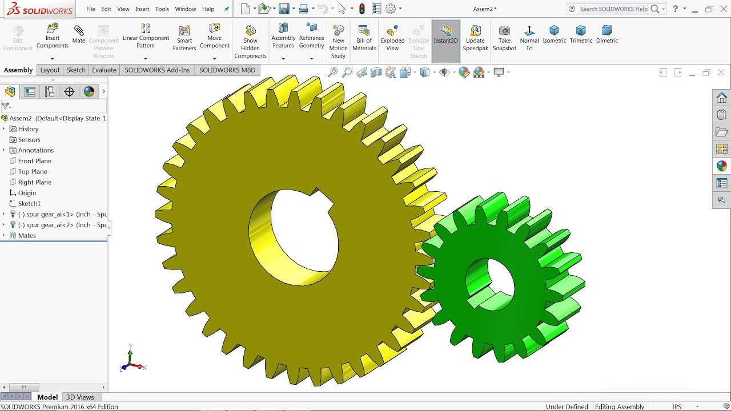
WHAT IS SOLIDWORKS?
SOLIDWORKS is a solid modeling computer-aided design (CAD) and computer-aided engineering (CAE) application published by Dassault Systèmes.
SOLIDWORKS is used to develop mechanical systems from beginning to end. At the initial stage, the software is used for planning, visual ideation, modeling, feasibility assessment, prototyping, and project management.
.

Slide 10
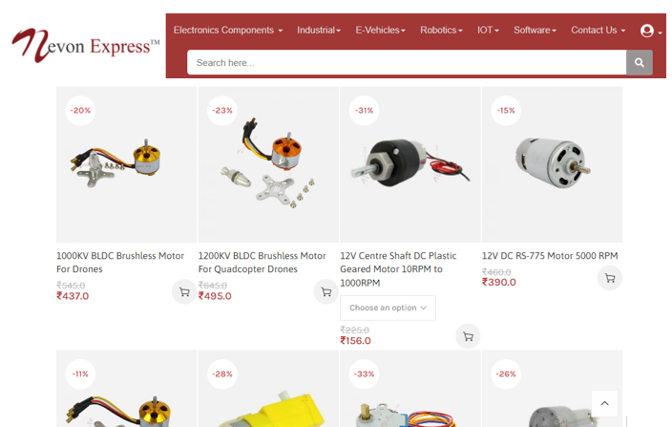
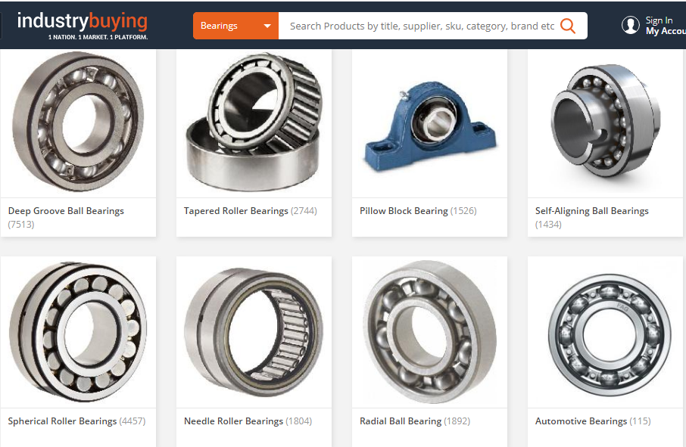
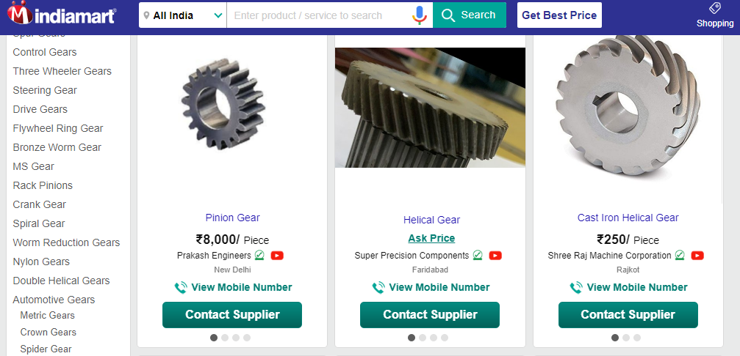
PARTS PROCUREMENT
Once the design is complete parts are to be procured so that project development may proceed.
Mechanical parts can be procured from local stores or online from www.indiamart.com, www.nevonexpress.in, www.industrybuying.com.

Slide 11



PARTS FABRICATION
It is a value added process that involves the creation of machines, parts, and structures from various raw materials. A fabrication shop will bid on a job, usually based on the engineering drawings, and if awarded the contract will build the product. Fabrication Processes:
Turning
Boring
Threading
Cutting
Welding
Drilling
Metal Cutting
Polishing

Slide 12

PROJECT ASSEMBLY
Mechanical assembly is a common term in the industrial and manufacturing context. It is the process used in the line of assembly production. As products are moved through the chain, parts are added at certain points of the line.

Slide 13

TESTING
Mechanical testing includes testing each part of the machine/robot individually for any defects incurred during the manufacturing defects followed by the complete testing after which the project is ready to be used.

Slide 14
THANKYOU

